Slide 1
ANAEMIA IN PREGNANCY
MBChB V

Slide 2
Presentation objectives
Define anaemia
Describe haematological changes in pregnancy, including iron metabolism
Explain the importance of anaemia in pregnancy
Outline the aetiology and classification of anaemia in pregnancy
Discuss the diagnosis of anaemia in pregnancy
Describe treatment and prevention of anaemia in pregnancy
Manage labor and puerperium in a patient with anaemia

Slide 3
Definition of Anaemia in Pregnancy
Insufficient number of red corpuscles or insufficient haemoglobin to deliver adequate oxygen to the body tissues
Difficult to define in pregnancy due to many variations; racial, smoking, iron supplementation, altitude
Anemia in non-pregnant women is defined as Hb< 12 g/dL

Slide 4
CDC definition:
Pregnancy Trimester | Hemoglobin | Hematocrit
First | 11.0 | 33.0
Second | 10.5 | 32.0
Third | 11.0 | 33.0

Slide 5
Definition of Anaemia in Pregnancy
Classification (WHO) based on severity
 | Hb g/dl
Mild | 10-10.9
Moderate | 7-9.9
Severe | <7

Slide 6
Haematological Changes in Pregnancy
The blood volume increases by about 50%, an adaptation to supply the needs of the new vascular bed.
The rbc mass cells increase by about 25%
Physiologic hydremia of pregnancy will lower the hematocrit but does not truly represent anemia and has no effect on the MCV
Not considered abnormal unless the levels fall too low(Hb<7g/dl are detrimental to the fetus)

Slide 7
Haematological Changes in Pregnancy
Additional need for Fe (3.0mg/day) above that of a non-pregnant, reproductive-age woman (1.3mg/day)
  350mg needed for fetal-placental growth
  250mg for blood loss at delivery(x3 at c/s delivery )
  450 mg for increases in maternal red cell mass
  baseline loss of 250mg
Lactation <6 months after delivery (not menstruating )her need are considerably lower; 0.3mg/day(men require 0.9mg/day).
Folic acid daily requirement doubles from 0.4 mg to 0.8 mg in pregnancy.

Slide 8
Haematological Changes in Pregnancy
Early Pregnancy | 20 – 32 weeks | 32 – 40 weeks
2.5 mg. / day | 5.5 mg. / day | 6.8 mg / day

Slide 9
Significance of Anaemia in Pregnancy
  Epidemiology
Global Maternal Mortality > 1/2 million maternal deaths annually
Anemia implicated in up to 40 % of maternal deaths in third-world countries
      Chronic anemia
      Infection
      Bleeding
      Hypertensive disorders
      Obstructed labour
      Unsafe abortion

Slide 10
Significance of Anaemia in Pregnancy
  Sequelae
Increased fatigue & decreased work performance
Cardiovascular stress; CCF
Low blood oxygen saturation: Placental
  Preterm birth
  Low birth weight
  IUFD
Impaired resistance to infection,postpartum infections
Poor tolerance to blood loss
Increased surgical intervention
Increased risks related to transfusion
Abruptio placentae, placenta praevia
Infantile anaemia 2-3 months post delivery

Slide 11
Aetiology of Anaemia in Pregnancy
  Risk factors
Low socio economic status
Young primigravidae
Too frequent or too many pregnancies
Heavy menses
Previous history of PPH or APH
Multiple pregnancy
Chronic Infections
Malabsorption
Drugs; phenytoin

Slide 12
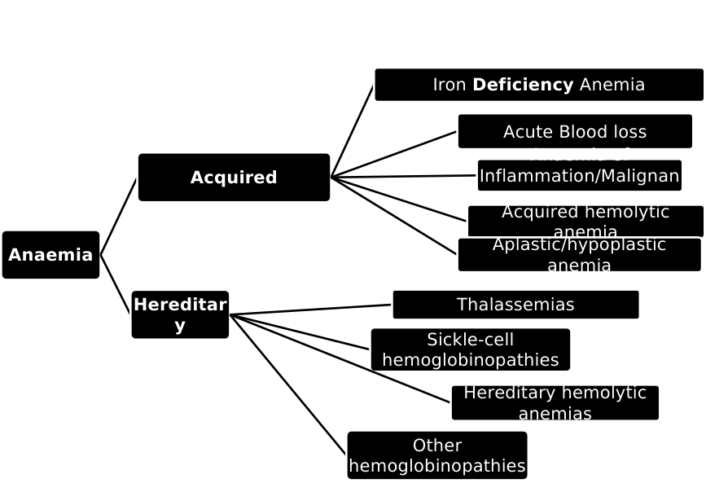
Etiology

Slide 13
Diagnosis of Anaemia in Pregnancy
  Clinical features of anaemia
Symptoms
Insidious and non-specific
General weakness, malaise, fatigue, lethargy or lassitude
Dizziness
Dyspnoea on slight exertion or breathlessness
Swelling of legs feet and face (oedema)
Headache
Palpitations/ rapid heartbeat (tachycardia)
Pica

Slide 14
Diagnosis of Anaemia in Pregnancy
  Clinical features of anaemia
Signs
  Related to cause: fever, jaundice
  Pallor
  Bipedal and sacral oedema
  Tachycardia
  Mid-systolic murmur
  Hepato-splenomegally
  Glossittis, stomatitis
  Koilonychia

Slide 15
Diagnosis of Anaemia in Pregnancy
  Clinical features of anaemia
Signs of CCF
Engorged neck veins
Congestion in the lung bases- crepitations
Tender hepatomegaly.
Edema
In terminal phase
Acute pulmonary edema
Cerebral anoxia- Mental confusion and loss of consciousness

Slide 16
Diagnosis of Anaemia in Pregnancy
  Laboratory investigations
Complete blood count and PBF:
  Hb concentration is easy to determine and a good indicator of the functional state of blood
  Microcytosis (MCV< 80 fL); IDA
  Macrocytic anemia (RBC MCV >100 fL), in the vit B₁₂ or folic acid deficiency,(hypersegmented neutrophils )
  Reticulocyte count, low in Folic & Vit B12 deficiency
  Hypochromia (MCHC < 32 g/100 mL, MCH < 27 pg)

Slide 17
Diagnosis of Anaemia in Pregnancy
  Laboratory investigations
Urinalysis: dipstick and microscopy
Stool for ova and cysts of hookworms, schistosomiasis, occult blood
Sickling test/ Hb electrophoresis
Bone marrow aspirate where necessary
LFTs for serum proteins as in chronic liver disease and hypoproteinaemia
U/Es + Cr + U.A to rule out underlying nephrosis

Slide 18
Diagnosis of Anaemia in Pregnancy
  Laboratory investigations
Serum iron (< 10 μmol/L or 40 ug/dL)
Transferrin
  Raised TIBC > 70 μmol/L
  Low transferrin saturation coefficient (TSC) = < 10%
Serum ferritin - Serum ferritin is a better indicator of iron stores but is expensive to undertake
CXR- to r/o intercurrent chronic chest infection

Slide 19
Prevention & Treatment of Anaemia in Pregnancy
Prevention of anemia:
Optimal birth spacing
Good pre-pregnancy nutrition
Healthy and balanced diet during pregnancy
Prophylactic medication – haematinics
Early detection of anaemia in pregnancy by screening all pregnant women (ANP) – first and last visits
Prophylactic antimalarials and antihelminthics

Slide 20
Prevention & Treatment of Anaemia in Pregnancy
  Treatment
Mainly directed at the cause
Supportive care: haematinics or/and blood transfusion or both, depending on:
  the degree of anaemia
  Symptomatology
  the gestational age

Slide 21
Prevention & Treatment of Anaemia in Pregnancy
  Treatment
Mainly directed at the cause
Supportive care: haematinics or/and blood transfusion or both, depending on:
  the degree of anaemia
  Symptomatology
  the gestational age

Slide 22
Summary Protocol of Severe Anemia in Pregnancy
Pregnancy < 30 weeks
Iron deficiency anemia
Folic acid deficiency
Oral iron
therapy
Oral folate
therapy
Intolerance or non-compliance
Intramuscular iron
Intravenous iron

Slide 23
Summary Protocol of Severe Anemia in Pregnancy
Pregnancy 30-36 weeks
Pregnancy >36 weeks
Iron
deficiency
Folic acid deficiency
Blood transfusion
Parenteral
iron
Oral folate
therapy
Intramuscular iron
Intravenous iron

Slide 24
Prevention & Treatment of Anaemia in Pregnancy
Transfusion (reactions, risk of transmission of disease)
for impending CCF,
patient in labour with severe anaemia
- watch for overload
- Packed RBCs is preferred
- Transfuse slowly (not more than 500mls in at least 6-8 hrs
Recombinant erythropoietin= iron (experimental, expensive)

Slide 25
Management of labor and puerperium
Labour and the first 2wks of the puerperium are the periods of greatest danger to the anaemic mother.
Most deaths occur in the first 12hrs after delivery
O₂ should be delivered in labour by mask to reduce the risk of foetal asphyxia

Slide 26
Management of labor and puerperium
Aseptic techniques to be employed due to decreased immunity
2nd stage should be shortened by assisted vacuum extraction or low forceps delivery
Antibiotic prophylaxis in the puerperium
Specific treatment for anaemia to continue for at least 6wks after delivery (puerperium) to accelerate recovery

Slide 27
Special Cases

Slide 28
Sickle Cell Disease in Pregnancy
Due to a genetic substitution of valine for glutamic acid at codon 6 of the globin chains;
1 in 400 births in blacks has SCD.
Affects about 0.2% of blacks.
8–10% of blacks carry the sickle cell trait.

Slide 29
Sickle cell crises
Vaso-occlusive
Sequestration
Aplastic (associated with parvovirus B19 Infection)
Painful
Hemolytic
Acute chest syndrome

Slide 30
Sickle cell anemia
Pregnancy
Increased risk of sickling during pregnancy; -metabolic requirements, vascular stasis, hypercoagulable state, infections (bacterial pneumonia, UTI), PET
Complications- abortion, IUGR, IUFD, Lbw, preeclampsia, preterm delivery, UTI, non-immune hydrops fetalis, placental abruption, and maternal mortality 1-2%.

Slide 31
Sickle cell anemia
Preconception care
Assess for frequency of crises, previous transfusion, endorgan damage (e.g nephropathy, heart failure and pulmonary hypertension).
Folate 5mg O.D started 3-6mons before conception.
Iron supplementation is discouraged
Hydroxyurea stopped 3-6 months before conception.

Slide 32
Sickle Cell Anaemia
ANC
Pneumococcal vaccine before pregnancy
Pregnancy dating, : risk of IUGR and may need early delivery.
FBC, LFTs, Renal function tests.
Folate supplementation, antibiotic prophylaxis.
Remain well hydrated and avoid heavy physical exertion, a cold environment and stress.
Multidisciplinary care by obstetrician and hematologist.
Serial obstetric scans in 3rd trimester to r/o IUGR
Crises Mx: pain relief, treatment of infections, oxygenation, correcting metabolic acidosis and maintaining an adequate haemoglobin level.

Slide 33
Sickle Cell Anaemia
Labour and intrapartum care
In the presence of IUGR, recurrent painful crises and other complications, induce labour at 34-37 weeks.
During labour: rehydrate O₂ by mask, asepsis; gxm and save blood.
Adequate analgesia.
FHR monitoring.
Regional block is preferable to GA

Slide 34
Sickle Cell Anaemia
Post partum care
There is an increased risk of PPH, hypovolaemia, tissue hypoxia, infections, thromboembolism and vaso-occlusive crises.
AMTSL ( Active Mx of 3rd Stage of Labour).
Antibiotic prophylaxis.
Early ambulation, thromboembolic deterrent stockings, appropriate hydration and oxygenation are encouraged.
Thromboembolic prophylaxis:daily sc heparin (e.g. 40 mg enoxaparin).
Adequate hydration and pain relief.
Breastfeeding encouraged.
Cord blood for Hb electrophoresis.
FP- low dose COCs, Progestins, IUCD

Slide 35
Malaria infestation
With its attendant haemolysis increases folate demand leading to megaloblastic anaemia.
Natural acquired immunity is lowered in pregnancy leading to excessive destruction of RBCs in some cases.

Slide 36
Hookworm infestation
Lives in the duodenum - the site of optimal iron absorption, therefore interfering with the latter by their attachments to the duodenal mucosa besides sucking blood from the patient (0.05 – 0.1ml per worm/ day), and leads to iron deficiency.

Slide 37
Other causes
Other helminthes and parasites e.g E. histolytica
Haemoglobinopathes e.g. thalasaemia and glucose 6-phosphate dehydrogenase deficiency.
Chronic diseases e.g. TB, HIV, Brucellosis, schistosomiasis, UTI, chronic liver and renal dx, and protein deficiency.

Slide 38
General measures
Protein intake- Should be adequate – at least 100grams per /day, 50% of which should preferably be animal protein
Chronic diarrhoeas – should be treated as they interfere with folic acid and B12 absorption
Hookworm – should be treated with non-toxic antihelminthics

Slide 39
CONCLUSION
Proper antenatal care and awareness programmes for prevention of anemia.
Adequate iron / folic acid prophylaxis in all antenatal cases.
Early detection and timely referral to tertiary centers.
Management to be decided depending upon the cause of anemia, type of anemia and severity of anemia.
Logical use of blood and blood components.
Proper intrapartum and postpartum care.
Motivation of the patient for acceptance of any contraceptive method.

Slide 40
Challenges in diagnosis, treatment and research
Ferritin is expensive and tedious to assay
Paucity of data due to lack of good quality trials
Benefits of physiological anemia are not understood
Variability of pathologic definition of anemia

